Slide 1
Deep Learning-Based Animal Re-Identification
for Non-Invasive Wildlife Monitoring and Conservation
MSc Thesis Defense (15 min)
Matej Maric - February 2026

Slide 2
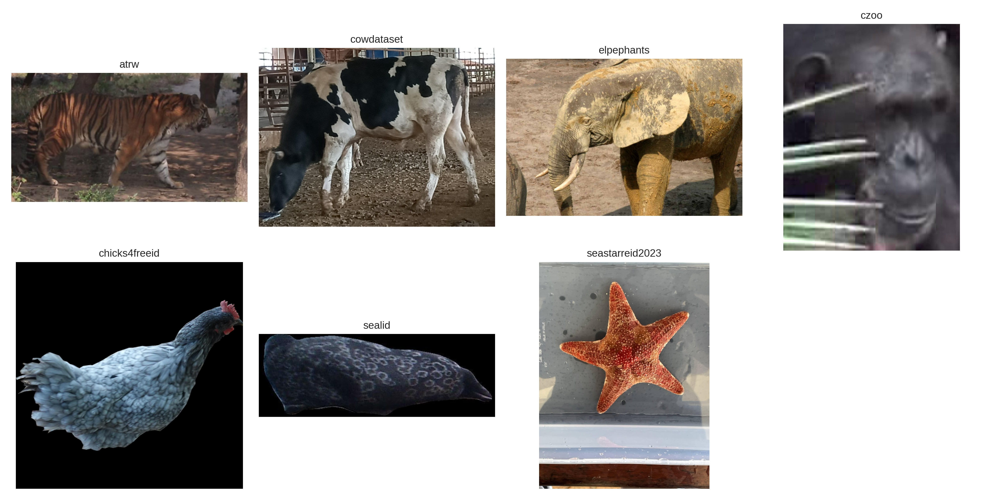
Motivation: Why a Species-Agnostic Pipeline?
- Unified pipeline across species
- Minimal supervision, practical runtime
- Re-ID as a building block for counting

Slide 3
Datasets: WildlifeReID-10k (7 Used Here)
WildlifeReID-10k: 37 datasets, 33 species, 140k images, 10.7k individuals.
Evaluated on 7 datasets spanning easy to hard cases (closed-set).
Dataset | # images | # individuals | split type
ATRW* | 5,415 | 182 | Original MD split
CZoo* | 4,662 | 71 | Original MD split
SealID* | 2,080 | 57 | Original MD split
CowDataset | 1,485 | 13 | Time-aware split
Chicks4FreeID | 1,146 | 50 | Similarity-aware split
SeaStarReID2023 | 2,187 | 95 | Time-aware split
ELPephants | 2,078 | 276 | Random split
* MD-trained datasets: use the exact training split to avoid additional leakage.

Slide 4
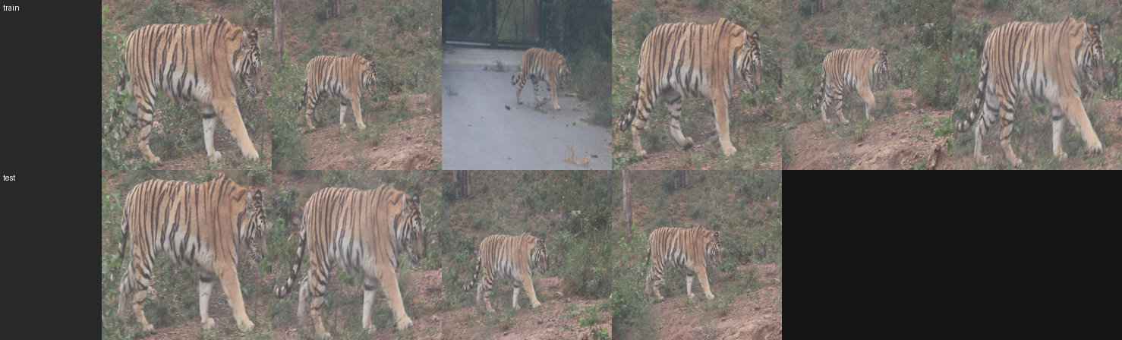
Evaluation Rigor: Leakage Control
- Time-aware splits
- Similarity-aware splits
- MD-train split alignment (ATRW/CZoo/SealID*)

Slide 5
Classification Funnel: Retrieve -> Rerank -> Verify
- Tier-1: retrieve candidates (Global + Fisher) and take the union
- Tier-2: calibrate and fuse scores into same-ID probability
- Tier-3: geometric verification (keypoints + RANSAC) on the shortlist

Slide 6
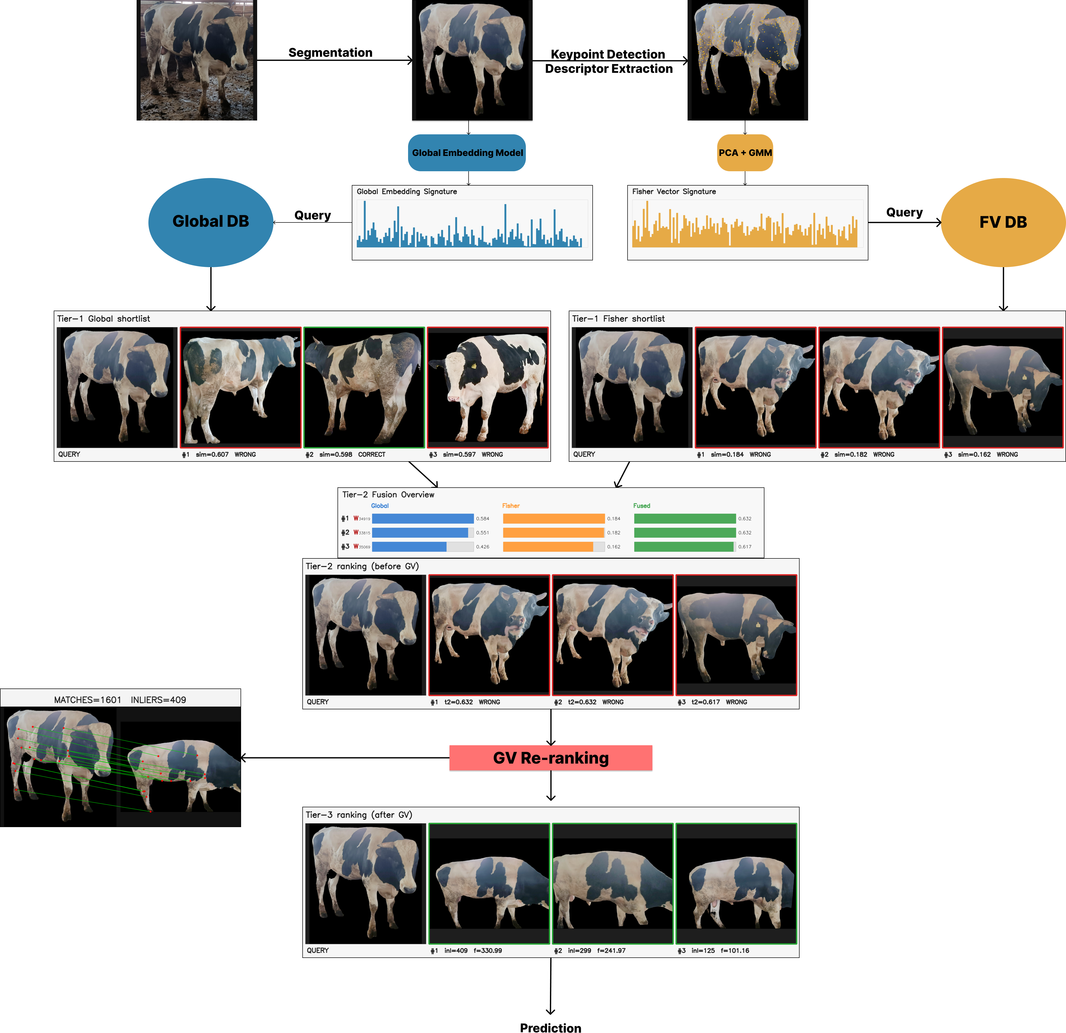
Pipeline Overview (Full)

Slide 7
Tier 1: Candidate Retrieval (Concept)
- Two fast signals: Global embeddings + Fisher vectors
- Take top-K from each and form an ordered union (deduped)
- Goal: high-recall shortlist for expensive stages
- Background removal helps stabilize local evidence (optional)

Slide 8
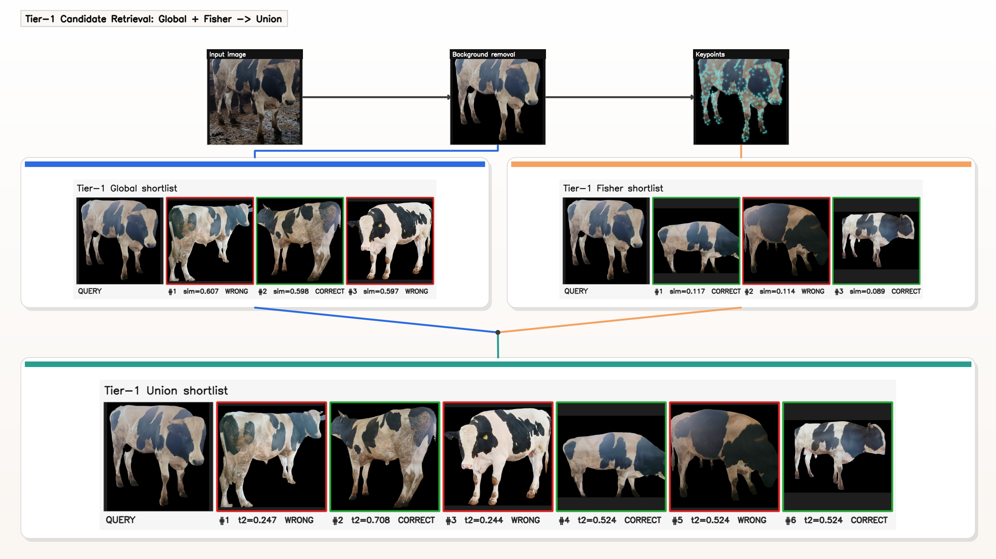
Tier 1: Candidate Retrieval (Visualization)

Slide 9
Tier 2: Calibration and Fusion (Concept)
- Raw similarities are not comparable across modalities
- Per-dataset calibration: score -> P(same | score)
- Fuse calibrated Global + Fisher (simple average)
- Output: Tier-2 reranking of the union shortlist

Slide 10
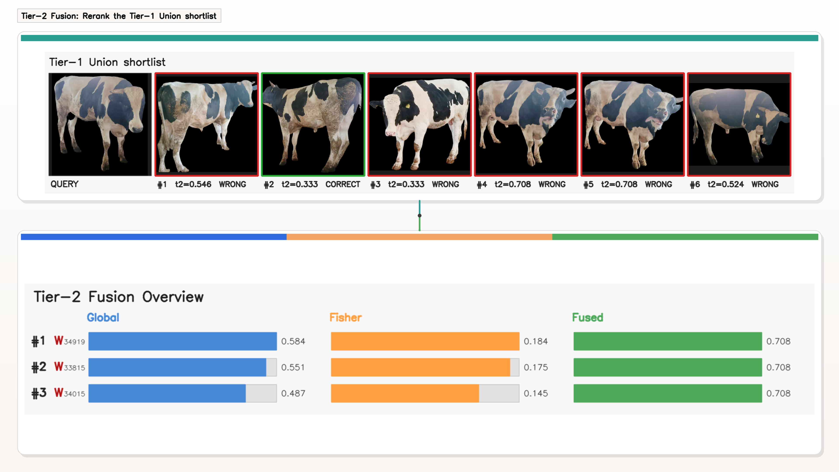
Tier 2: Calibration and Fusion (Visualization)

Slide 11
Tier 3: Geometric Verification (Concept)
- Run only on a small shortlist (most expensive stage)
- Match local keypoints and estimate geometric consistency
- Inlier count provides strong evidence against false matches
- Especially helpful on hard datasets (e.g., ELPephants)

Slide 12
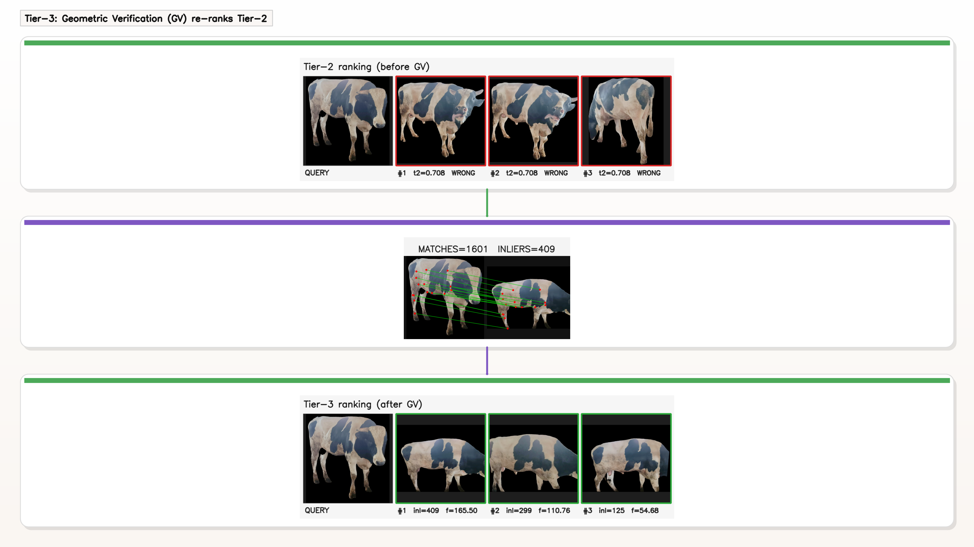
Tier 3: Geometric Verification (Visualization)

Slide 13
Classification Results (Mean over 7 datasets)
Metric | Global | WildFusion | This thesis
Top-1 (%) | 71.75 | 88.18 | 86.73
Top-5 (%) | 79.58 | 91.91 | 90.70
F1 (%) | 71.51 | 87.35 | 85.70
Runtime (min) | 0.06 | 214.52 | 42.53
- WildFusion: strong calibrated fusion baseline
- GV is expensive -> applied only on a shortlist
- Key point: near-WildFusion accuracy at ~5x lower runtime

Slide 14
Classification Results (Selected Datasets)
Dataset | Metric | Global | WildFusion | Fisher | G+F | F+GV | G+F+GV
ELPephants | Top-1 | 13.66 | 49.31 | 20.79 | 21.58 | 46.73 | 54.46
 | Top-5 | 21.78 | 57.03 | 31.49 | 32.48 | 68.12 | 64.95
 | F1 | 11.58 | 45.19 | 18.21 | 19.26 | 42.87 | 49.71
SealID* | Top-1 | 78.42 | 97.60 | 65.23 | 79.38 | 81.53 | 85.13
 | Top-5 | 79.62 | 98.56 | 80.58 | 82.73 | 89.69 | 88.97
 | F1 | 77.86 | 97.67 | 64.59 | 78.47 | 80.58 | 84.40
SeaStarReID2023 | Top-1 | 47.91 | 80.47 | 68.84 | 62.79 | 77.21 | 77.21
 | Top-5 | 73.49 | 90.70 | 85.58 | 82.79 | 85.58 | 85.58
 | F1 | 45.71 | 79.09 | 67.92 | 60.70 | 76.40 | 76.85
GV gain (ELPephants Top-1): 21.58 (G+F) -> 54.46 (G+F+GV).

Slide 15
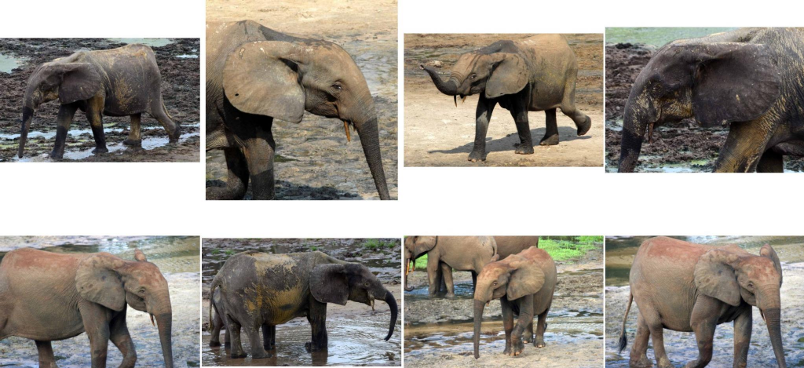
ELPephants: A Stress-Test for Local + GV
- Smooth texture -> weak global cues
- Strong pose/illumination/mud variation
- Local evidence + GV is crucial
- Best Top-1: 54.46% (vs 49.31% WildFusion)

Slide 16
Population Counting: HITL-NIS (Idea)
- Goal: estimate #individuals without full clustering
- Model images as clique graph -> connected components
- Query only a small number of pairs (oracle: same/different)
- Use Nested Importance Sampling to reduce variance
K = Σu 1 / (1 + d(u))
N vertices, M neighbors

Slide 17
Counting Drawbacks: Human Error Matters
- Pair labels are highly imbalanced (mostly 'different')
- False positives merge identities -> underestimation collapse
- Confidence intervals capture sampling variance, not bias
- Mitigation: positive confirmation (accept 'same' only after K votes)

Slide 18
Population Results (K=2): Full Table
 | ATRW | CowDataset | Chicks4FreeID | CZoo | ELPephants | SealID | SeaStarReID2023
#images | 5415 | 1388 | 1086 | 2109 | 2078 | 2080 | 2077
GT | 182 | 12 | 48 | 24 | 274 | 57 | 91
p=0.00 | 278 [132, 425] | 12 [11, 13] | 50 [43, 58] | 24 [23, 26] | 334 [267, 401] | 56 [45, 68] | 106 [85, 128]
0.02 | 212 [124, 300] | 13 [11, 14] | 50 [42, 57] | 25 [23, 27] | 320 [259, 381] | 65 [47, 83] | 106 [87, 126]
0.05 | 178 [116, 240] | 13 [12, 14] | 47 [41, 54] | 26 [24, 27] | 178 [157, 199] | 53 [43, 62] | 93 [79, 106]
0.10 | 72 [58, 86] | 13 [12, 14] | 39 [34, 43] | 25 [23, 27] | 78 [73, 83] | 45 [37, 54] | 59 [52, 66]
0.15 | 39 [34, 45] | 12 [11, 14] | 27 [24, 30] | 22 [20, 24] | 40 [38, 43] | 33 [29, 38] | 37 [33, 41]
0.30 | 11 [10, 12] | 8 [7, 9] | 10 [9, 11] | 13 [11, 14] | 11 [10, 12] | 13 [11, 15] | 11 [10, 12]
Bold: GT inside the 95% confidence interval.

Slide 19
Population Results (K=1): Full Table
 | ATRW | CowDataset | Chicks4FreeID | CZoo | ELPephants | SealID | SeaStarReID2023
#images | 5415 | 1388 | 1086 | 2109 | 2078 | 2080 | 2077
GT | 182 | 12 | 48 | 24 | 274 | 57 | 91
p=0.00 | 278 [132, 425] | 12 [11, 13] | 50 [43, 58] | 24 [23, 26] | 342 [298, 386] | 56 [45, 68] | 106 [85, 128]
0.02 | 40 [33, 46] | 10 [9, 11] | 25 [22, 28] | 19 [17, 20] | 42 [41, 44] | 29 [25, 34] | 36 [32, 40]
0.05 | 18 [16, 20] | 8 [7, 9] | 15 [13, 16] | 13 [12, 15] | 19 [18, 20] | 17 [15, 20] | 18 [16, 20]
0.10 | 10 [9, 11] | 6 [5, 7] | 9 [8, 10] | 9 [8, 10] | 10 [9, 10] | 11 [9, 12] | 10 [9, 11]
0.15 | 7 [6, 7] | 5 [4, 5] | 6 [5, 7] | 7 [6, 8] | 7 [6, 7] | 8 [7, 8] | 7 [6, 7]
0.30 | 3 [3, 4] | 3 [2, 4] | 3 [3, 4] | 4 [3, 5] | 3 [3, 4] | 4 [3, 5] | 3 [3, 4]
Bold: GT inside the 95% confidence interval.

Slide 20
Conclusions
- Species-agnostic 3-tier Re-ID works across multiple benchmarks
- Global + Fisher + GV gives strong accuracy/runtime trade-off
- HITL-NIS is promising, but very sensitive to human error

Slide 21
Future Work
- Validate counting with real annotators (not simulated error)
- Better global backbone and stronger local matching for hard datasets
- Link photographed-individual counts to true abundance/density

Slide 22
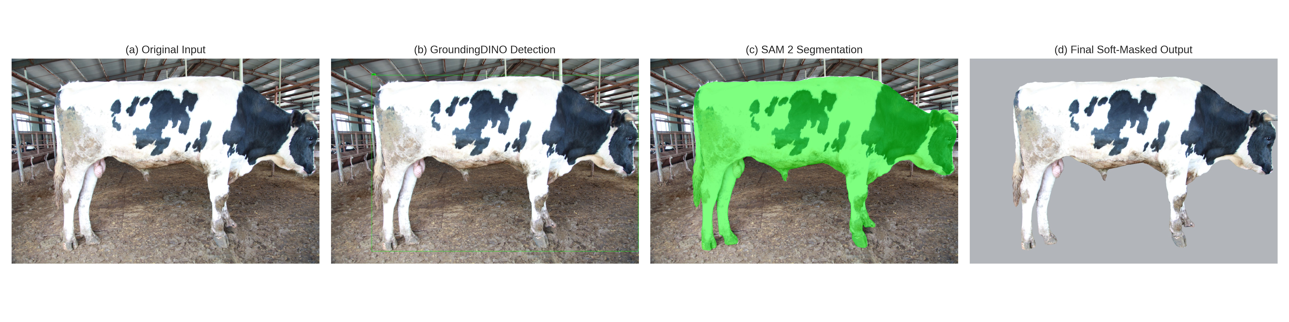
Thank you
Questions?

